Slide 1
DEPARTMENT OF METEOROLOGY KNUST, GHANA
A STUDY ON ENSO AND MAIDEN-JULIAN OSCILLATON
NAME: OTI JAMES ACHEAMFOUR ANTWI
INDEX NUMBER:9474919

Slide 2
EL NinO-Southern Oscillation(ENSO)
ENSO is an irregularly periodic variation in winds and sea surface temperatures over the tropical eastern Pacific Ocean, affecting the climate of much of the tropics and subtropics.
ENSO mostly occurs in the southern hemisphere just right below the equator
ENSO occurs on the pacific ocean which is a large pool of water that exists on the western side of the South American continent and the eastern side of the Asian and Australian continent
it naturally swings between three key phases that are; La Nina, neutral, and El Nino

Slide 3
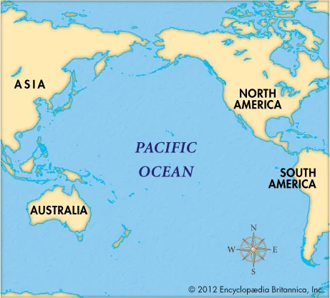
THE PACIFIC OCEAN

Slide 4
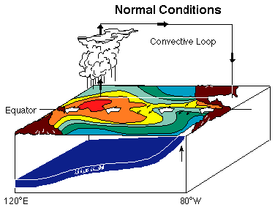
THE NORMAL PHASE
During this phase, steady trades blow across the tropical Pacific from the east to west
These winds pile up warm water in the western pacific
In contrast water temperature to the east are lower as the trade wind cause cool water to be drawn up from the deep
The temperature difference across the tropical pacific ocean causes air to rise to Australia’s north and descend near south America
This creates a huge connected cycle called the walker cycle

Slide 5
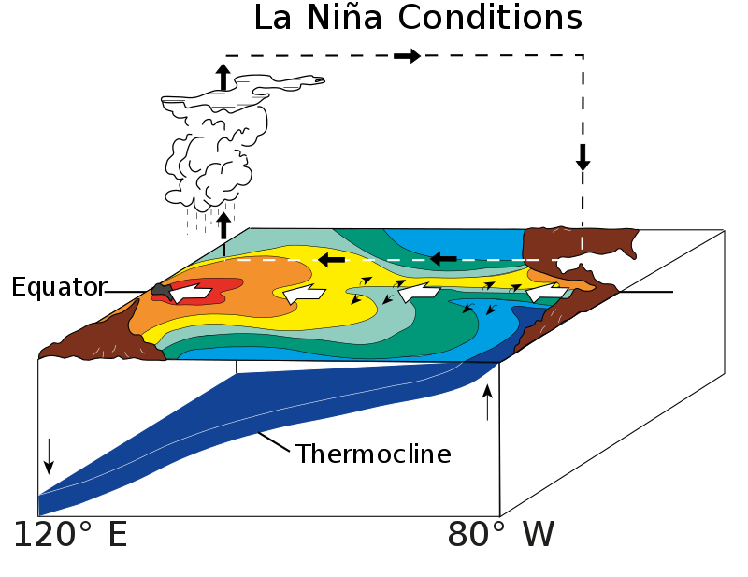
LA NINA(overdrive of the neutral phase)
In this phase, the trade winds blow harder, expanding the warm pool on the Australian side of the tropical pacific and cooling the oceans toward South America
This results in an increase in the east to west temperature difference and makes the Walker circulation even stronger and the trade winds blow even harder again
With the higher ocean temperatures in the western pacific, there is going to be greater evaporation, more clouds, and more rains there.

Slide 6
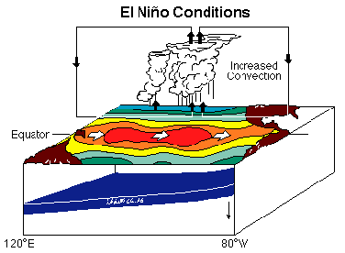
EL NINO(direct opposite of la nina)
During El Nino, the trade winds actually weaken, or reverse allowing warmer waters to drift back towards the east
The change in the ocean temperature patterns means that the walker circulation breaks down, resulting in even weaker trade winds and even more warming in the east
Once this feedback starts, El Nino has set in.
With the warm water shifting east, the evaporation, clouds, and rain follows shifting away from the western pacific
That means a greater risk of drought, high temperatures and clear nights, fewer tropical cyclones, etc. for northern and eastern Australia
And in contrast more heavy rain and flood on the American continent

Slide 7
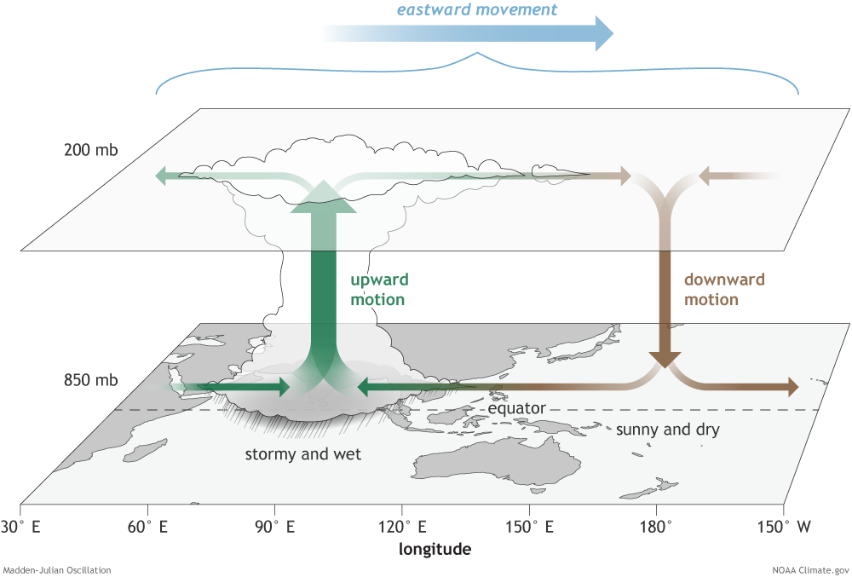
MAIDEN JULIAN OCSILLATION(MJO)
The MJO is an of the important climate driver of tropical weather around the globe. it was discovered by Roland Madden and Paul Julian in 1971.
The MJO is a disturbance of clouds, rainfall, winds, and pressure that moves eastward around the planet near the equator. It takes on average 30 to 60 days to circle the globe.
It affects the tropical weather on a weekly to monthly timescale
The MJO has 8 phases
It’s a traversing phenomenon and is most prominent over the Indian and pacific ocean

Slide 8
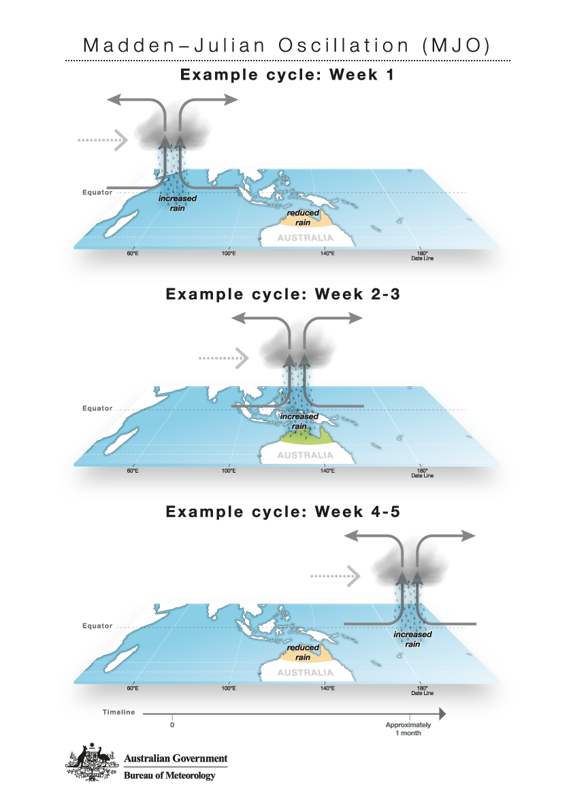
MAIDEN JULIAN OCSILLATION(MJO)
When that extra cloud arrives it can increase the chance of receiving above-average rainfall
However ahead and behind the tropical cloudiness are regions where it might be drier than usual
Also it influences the formation of tropical cyclones
In the northern Australia wet season (October to April), the MJO can influence the timing, variability, and strength of Australia’s monsoon
It also has a relationship with the ENSO; it can bring periods of weaker trade winds over the pacific which in the long run strengthen the EL Nino
It can also weaken la Nina

Slide 9
REFERENCES
LINKS
El Niño–Southern Oscillation – Wikipedia
(402) What is ENSO, El nino, La nina, Southern Oscillation, Walker Circulation | UPSC / IAS – YouTube
(402) Understanding the Madden–Julian Oscillation (MJO) - YouTube

